Slide 1

Patching Automation
Steven Sanders

Slide 2

The Problem:
Patching Compliance

Slide 3

The Proposal
We Patch on Week 3
We patch on week 3 every day at midnight with a reboot
We offer a reboot yourself option and hold the owner responsible(This is a courtesy, Can implement with no exceptions)

Slide 4
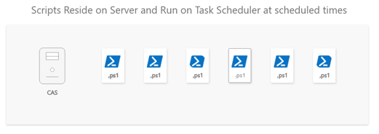
The Design (Going for Simple)
We have 8 Collections for week 3
We automate monthly software update group creation leveraging ADRs
Reporting will be automated with an email subscription and Custom Report
We design this with simplicity to stop the automation if something were to go wrong
An admin should be able to go in to task scheduler and stop all of the scripts. (Can create a script to act as an On/Off button if requested)

Slide 5
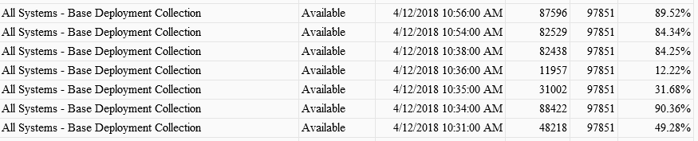
Reporting
This subscription report will look similar to this
This is just for example only (We wouldn’t deploy to “All Systems”)

